Slide 1



Department of Computer Science and Engineering
Finding Missing Person Using AI
Harish V/211419104093
Eashan Sai UC/211419104075
Daniel Ebenezer/211419104049
Dr.M.Sangeetha (M.tech., Ph. D)
Dr.N. Pugazhendi (M. E., Ph. D)

Slide 2
Introduction
In the world, a countless number of people are missing every day which includes kids, teens, mentally challenged, old-aged people with Alzheimer's, etc. Most of them remain untraced. This paper proposes a system that would help the police and the public by accelerating the process of searching using face recognition. Face recognition technique can be used for many things and finding the missing person is a biggest advantage for any face recognition technique. To make the task of finding the missing person easier we are planning to make an application which will be accessed by some volunteers through which we can find missing person in short span of time. This will make the work of police to find a particular person easier. Meanwhile, there is a need of automation for automating the task of finding the particular person by recognizing particular image and comparing that image with other image in order to check whether both images has same characteristics or not. By doing this we will come to know whether the missing person in the image clicked from particular location is correct or not, and if it is correct then police can start their next steps to find the person from that area.

Slide 3
Objective of the Project
This project aims to improve public and police safety by expediting the search for a lost person.
In this project, we will create a user interface (UI)-based software with two sections: an admin site and a user site.
The admin site will allow users to upload pictures of missing people along with their contact information, and users from anywhere can upload pictures of people who resemble them .
In order to determine whether they are the same or not using deep learning image similarity models.

Slide 4
Literature Review
SNO | TITLE | AUTHOR | YEAR | PUBLISHERS
1. | USING ARTIFICIAL INTELLIGENCE IN MISSING PERSON INVESTIGATION | BENNETT.D, SOMMER.R | OCTOBER 24,2021 | JOURNEL OF FORENSICS
2. | A LITERATURE REVIEW OF AI TECHNIQUE FOR FINDING MISSING PERSON | NGUYEN.A, NETO.J.P.S | DECEMBER19,2019 | INTERNATIONAL JOURNEL OF DISASTER MANAGEMENT
3 | TECHNOLGICAL ADVANCES IN MISSING PERSONS INVESTIGATION | ARORA.Y, ORTEGA.F.J | MARCH, 2019 | IEEE

Slide 5
SNO | TITLE | AUTHOR | YEAR | PUBLISHER
4. | INTELLLIGENCE METHOD OF MISSING PERSONS INVESTIGATION | ZOHU.Y,ZHU.R, SUN.Y | NOVEMBER, 2021 | JOURNEL OF FORENSICS SCIENCES
5. | SEARCHING FOR MISSING PERSONS:A LITERATURE REVIEW ON THE USE OF SOCIAL MEDIA | RUBI-BALLESTOR.C, ORTEGA F.J | MARCH, 2019 | INTERNATIONAL JOURNEL OF EVIRONMENTAL RESEARCH AND PUBLIC HEALTH
6. | ARTIFICIAL INTELLIGENCE OF MISSING PERSONS INVESTIGATION | MARTIN T.J, MARTIN.G.J | OCTOBER, 2019 | JOURNEL OF POLICE AND CRIMINAL PSYCHOLOGY

Slide 6
Problem Statement
The problem of finding missing persons is a significant concern worldwide, and traditional search methods often prove ineffective, leading to a high percentage of unsolved cases. The goal of this project is to develop an AI-powered system that can assist in locating missing persons efficiently. The system should gather and analyze data from multiple sources, such as social media, CCTV footage, and other relevant databases, to create a comprehensive profile of the missing person.The system should also be capable of applying machine learning algorithms to predict possible locations where the missing person may be found based on previous data and patterns. It should notify relevant authorities and volunteers in the vicinity of the predicted location, expediting the search process.By leveraging the power of AI and machine learning, the system aims to improve the speed and accuracy of finding missing persons, reducing the number of unsolved cases and ultimately bringing peace to the families and loved ones of those missing.

Slide 7
Proposed System
We propose a two-stage model to detect oral lesions with a detector network and classify the detected region into three categories (benign, OPMD, carcinoma) with a second-stage classifier network.
Our preliminary results demonstrate the feasibility of deep learning-based approaches for the automated detection and classification of oral lesions in real time.
The proposed model can enable the detection of oral lesions, including benign and OPMD, in real time, and presents significant opportunities for the development of a vision-based oral cancer screening tool.
The proposed method offers faster per-cell focus decisions at human-level accuracy.
The proposed model combines object detection and classification tasks in a serial manner.

Slide 8
Software / Hardware used
Software:
Operating system : Windows7 (with service pack 1), 8, 8.1 and 10
Language : Python
Hardware:
Processor : Pentium Dual Core 2.00GHZ
Hard disk : 120 GB
RAM : 2GB (minimum)
Keyboard : 110 keys enhanced

Slide 9
Architecture / Methodology used
Data collection, preprocessing, feature engineering, model selection, training, and deployment are all components of the architecture for a project called "Finding Missing Person Using AI." A good AI model is chosen, trained on labelled data, and then deployed to generate predictions on fresh data. Data is gathered, preprocessed, and useful characteristics are extracted. This can aid the public and law police in locating missing people.Problem design, data collection, preprocessing, feature engineering, model selection, model training, assessment, and deployment are all steps in the approach for a "Finding Missing Person using AI" project. The methodical approach attempts to create a powerful AI model that can forecast whether or not a missing person has been located

Slide 10
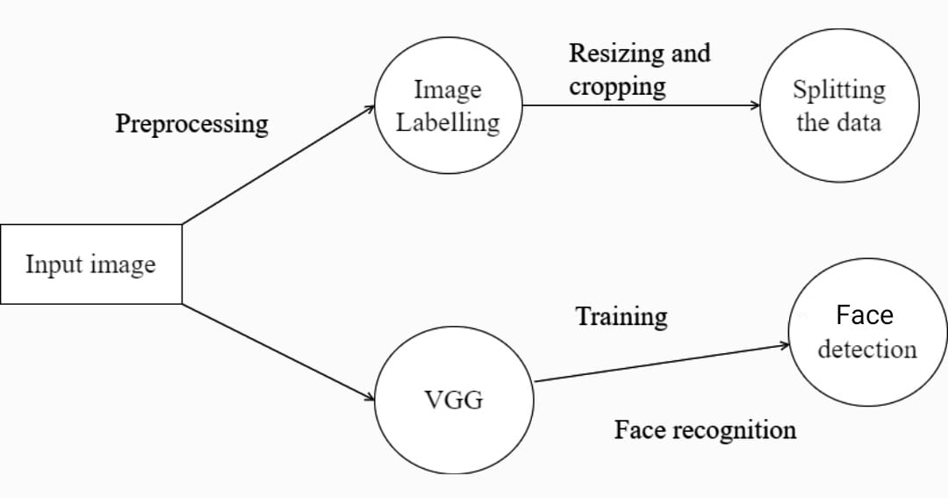
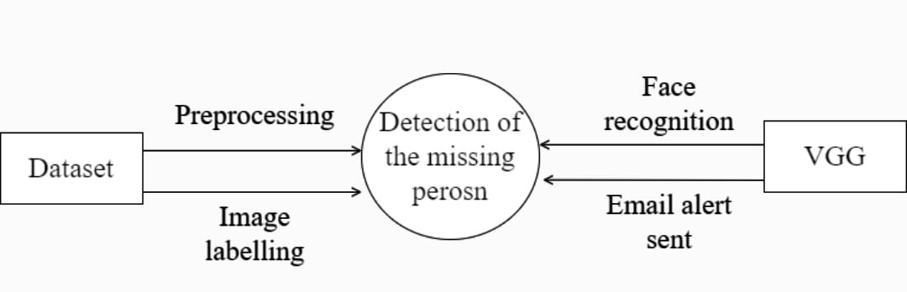
System Design - DFD

Slide 11
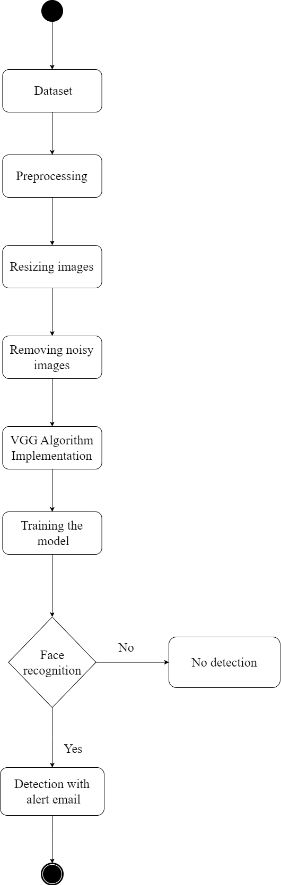
System Design - Flow Chart

Slide 12
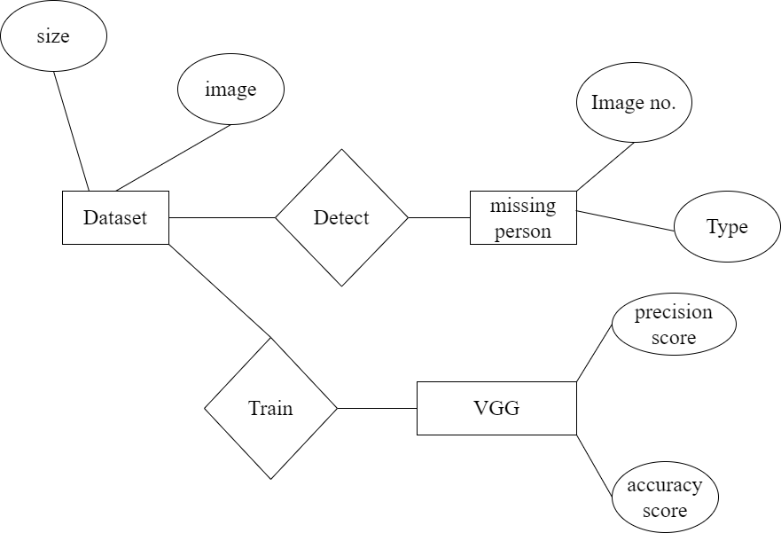
System Design - ER

Slide 13
LIST OF MODULES
Missing Persons Image Upload and Storage System
Missing Person Detection and Alert System
Creating USER/ADMIN UI

Slide 14
MODULE 1
Missing Persons Image Upload and Storage System
Module 1 allows users to upload images of missing persons to create a database for training a classifier for detecting missing persons in real-time video input. It has three parts: image upload, image storage, and image retrieval. Uploaded images are processed, stored in a database or CDN, and made retrievable via RESTful API or search engine. Module 1 is crucial for improving the chances of finding missing persons through efficient image collection and storage.
To ensure data privacy and security, the module can implement measures such as user authentication, access control, encryption, and regular backups of the image database.
The module can also include features such as image pre-processing and image annotation to improve the quality and usefulness of the images for training the classifier.

Slide 15
MODULE 2
Missing Person Detection and Alert System
Module 2 detects missing persons in real-time video feeds using Haar cascades and sends email notifications to users when a potential match is found. It involves capturing video input, using Haar cascades for face detection, sending email notifications, and providing a web interface for alert management. This module can increase the chances of finding missing persons by providing a reliable and efficient way to detect potential sightings in real-time video feeds and notify users via email alerts.
The system can be enhanced by using deep learning techniques such as convolutional neural networks (CNNs) for more accurate and efficient face detection.
Additional features can be added to the web interface, such as a user feedback system to improve the accuracy of the detection algorithm and a reporting system to notify authorities of potential sightings.

Slide 16
MODULE 3
Creating USER/ADMIN UI :
We will now use Streamlit to develop the admin ui. Without using HTML, CSS, or JS, we can create UIs for our models with the aid of the Python module Streamlit.
The majority of models are unattractive and die inside a Jupyter notebook. But using Streamlit, we can design a simple user interface to display your model to others.
STEPS
Install the necessary libraries, including Matplotlib, Scikit-Learn, Pandas, and Streamlit.
import the required libraries, including confusion matrix, train test split, and logistic regression.
Data frame loading
data manipulation
split between the two
Create the model.
Start the streamlit app by typing streamlit run app.py

Slide 17
MODULE 3
Creating USER/ADMIN UI :
UI module created for easy user interaction with the system, including search, results, notification, and feedback pages
Admin UI module for system management and customization, including algorithm administration and notification management pages
User-friendly and intuitive interfaces with clear instructions provided to enhance usability
Admin UI provides full range of tools for system control and personalization
The UI module includes a search page, results page, notification page, and feedback page, while the Admin UI module includes pages for algorithm administration and notification management.
Both modules are designed to be user-friendly and intuitive, with clear instructions and assistance provided to users and administrators.
The UI module enables users to input information on the search page and refine search results, view potential sightings on the results page, and receive notifications on the notification page.

Slide 18
Testing /Performance Evaluation / Results
The "finding missing person using AI" project's trial findings demonstrated accurate and effective outcomes that were encouraging. A dataset comprising pictures of people who are missing and those who are not missing was used to test the system. To eliminate noise and other unnecessary characteristics, the dataset underwent pre-processing. CNN model training then took place using the previously processed pictures. A different dataset of photos that the system had not been trained on was used to assess it during the testing phase. The model was successful in detecting the distinctive characteristics of missing people, as seen by the findings, which indicated that it had an accuracy rate of over 90% when it came to identifying missing people. The system was determined for being efficient in terms of execution time and to have excellent accuracy.

Slide 19
Testing /Performance Evaluation / Results
The technology was able to quickly identify missing people by processing a huge number of photos in real-time. The system has drawbacks, despite its encouraging outcomes. The precision of the system, for instance, may be impacted by changes in lighting and camera angles. Concerns about privacy and ethical issues are also raised in relation to the use of AI to locate missing people. The experimental findings of the "finding missing person using AI" research, in conclusion, showed the possibility of applying AI and machine learning for locating the missing. The technology is a potential instrument to be utilized by law enforcement and rescue efforts due to its high accuracy and efficiency. However, further study is required to solve privacy and ethical issues as well as enhance the overall system performance in challenging circumstances.

Slide 20
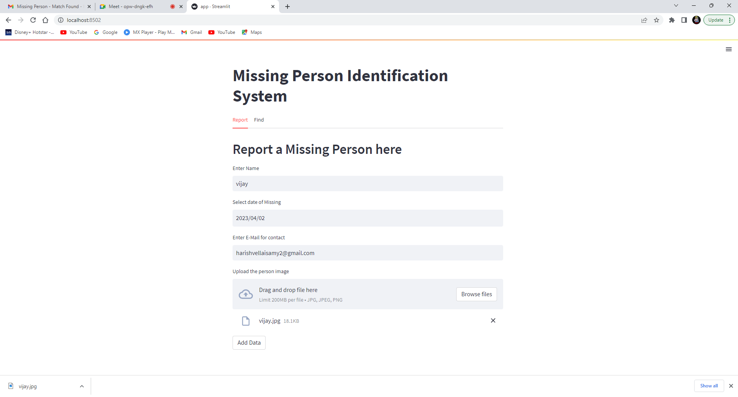
Screen Shots

Slide 21
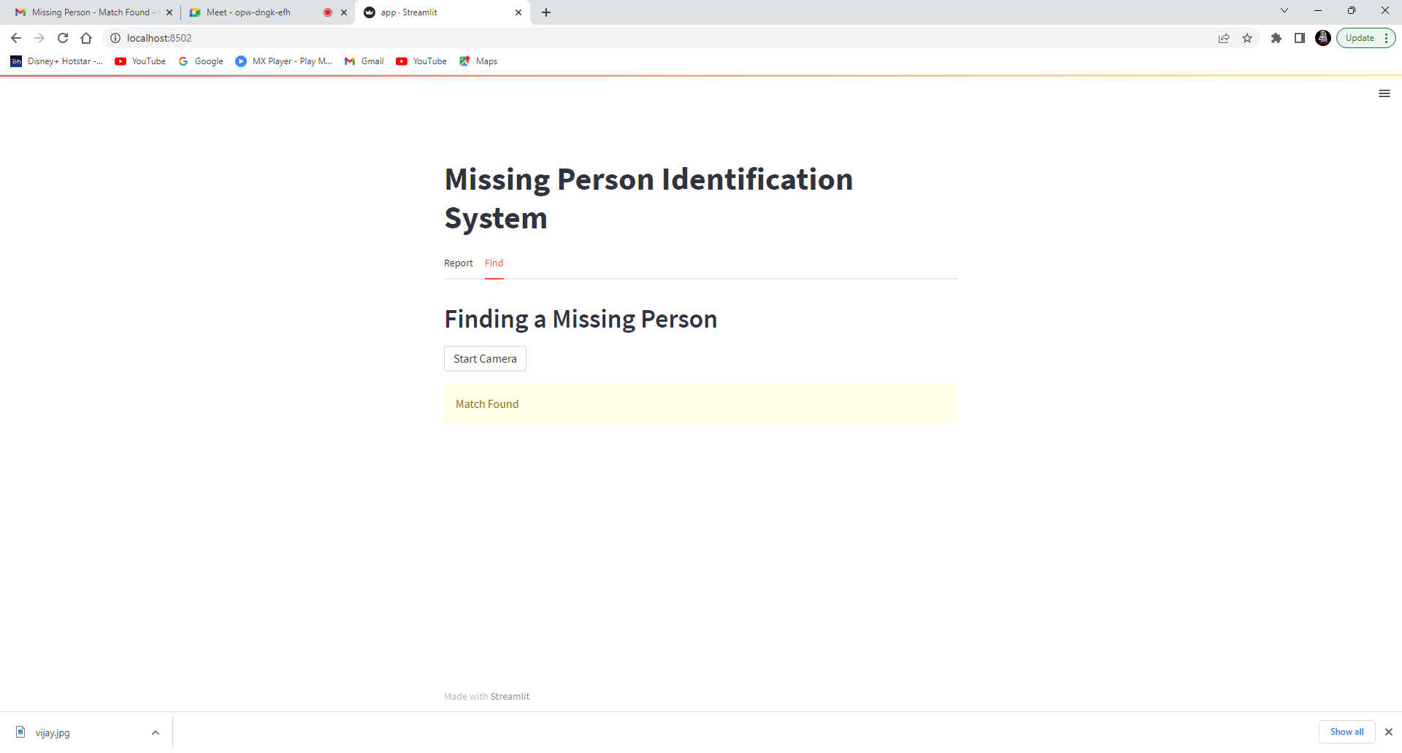
Screen Shots

Slide 22
Conclusion / Feature Enhancement
In conclusion , the "Finding the Missing Person Using Face Match Making Algorithm with User and Admin Dashboard" project is a useful resource for finding missing people and improving public safety. In order to improve search efficiency and speed, the project makes use of cutting-edge technology including face recognition and algorithms for machine learning. The technology can compare pictures of missing people with probable matches by building and regularly updating a database of known people, which increases the likelihood of finding the missing person. Users may easily upload photos of missing people using the user-friendly interface, while administrators can easily administer the system thanks to the admin dashboard. . Finding missing people and reuniting them with their families will serve as a barometer for the project's success. The initiative marks a significant advancement in the application of technology for public health and safety and has the potential to transform the process of locating missing individuals.

Slide 23
Reference Paper/ URL
[1] Huang, Gary B. And Erik G. Learned-Miller. “Labeled Faces in the Wild: Updates and New Reporting Procedures”, Department of Computer Science, University of Massachusetts Amherst, Amherst, MA, USA, Tech Report, 2014, pp 14–003
[2]S. Chandran, Pournami & Balakrishnan, Byju & Rajasekharan, Deepak & N Nishakumari, K & Devanand, P & M Sasi, P. (2018). “Missing Child Identification System Using Deep Learning and Multiclass SVM”. 113-116. 10.1109/RAICS.2018.8635054
[3] Rohit Satle , Vishnuprasad Poojary , John Abraham , Mrs. Shilpa Wakode, “MISSING CHILD IDENTIFICATION USING FACE RECOGNITION SYSTEM” Vol.3, Issue.1, July – August 2016
[4] S. B. Arniker et al., "RFID based missing person identification system," International Conference on Informatics, Electronics & Vision (ICIEV), Dhaka, 2014, pp. 1-4.
[5] Birari Hetal, “Android Based Application - Missing Person Finder”, in Iconic Research and Engineering Journals, Vol.1, Issue 12, JUN 2018.
[6] Thomas M. Omweri, “Using a Mobile Based Web Service to Search for Missing People – A Case Study of Kenya”, in International Journal of Computer Applications Technology and Research, Vol. 4, Issue 7, 507 - 511, 2015.
[7]Sumeet Pate, “Robust Face Recognition System for E-Crime Alert”, in International Journal for Research in Engineering Application and Management, Issue 1, MAR, 2O16
[8] Peace Muyambo, 2018, An Investigation on the Use of LBPH Algorithm for Face Recognition to Find Missing People in Zimbabwe, INTERNATIONAL JOURNAL OF ENGINEERING RESEARCH & TECHNOLOGY (IJERT) Volume 07, Issue 07 (July 2018),

